Slide 1


Slide 2
Agenda
Challenges before ansible
Introduction to ansible
Why use ansible?
Main features
Basic Terminologies
Architecture
How ansible works?
Installing ansible
And much more…

Slide 3
Challenges before Ansible
Installing or deleting application in large number of computers
Rolling back changes
Downtime is high since there is no automation
Less productivity

Slide 4
Introduction to Ansible
Ansible is simple open source IT engine which automates application deployment, intra service orchestration, cloud provisioning and many other IT tools.
Apply changes to your system to bring it to a desired states.
Follows Push-Model.
Similar application includes puppet, chef, salt, juju, cfengine.

Slide 5
Why use Ansible?
Free open source application
Python/YAML based.
Simple and human readable.
Highly flexible & configuration management of system.
Large number of ready to use modules for system management.
Target system requires only sshd and python.
Security relies on ssh.

Slide 6





















Main Features

Slide 7
Installing Ansible
On Ubuntu:
$ sudo apt update
$ sudo apt install software-properties-common
$ sudo apt-add-repository ppa:ansible/ansible
$ sudo apt update
$ sudo apt install ansible
Or
$ sudo pip install ansible
If you have other distribution, then visit: https://docs.ansible.com/ansible/latest/installation_guide/intro_installation.html

Slide 8
Basic Terminologies
Controller node: The machine where ansible is installed, responsible for running the provisioning on the servers you are managing.
Remote node: Machines on which changes to be made.
Inventory: An initialization file that contains information about the servers you are managing.
Playbook: The entry point for Ansible provisioning, where the automation is defined through tasks using YAML format.
Play: A provisioning executed from start to finish is called a play. In simple words, execution of a playbook is called a play.
Module: A module typically abstracts a system task, like dealing with packages or creating and changing files.

Slide 9
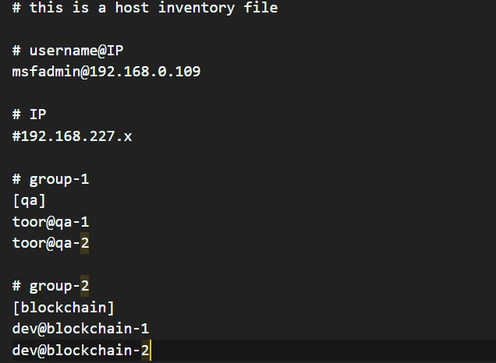
Inventory File
Plain text file
File containing remote hosts
It might contain IP address or FQDN.
Default ansible host file: /etc/ansible/hosts

Slide 10
Playbooks
Ansible commands & modules embedded in YAML file
Used to perform complex tasks
Case-sensitive & Indentation sensitive
Use built-in or plugin modules
Easy to code and human readable
to be continued…

Slide 11
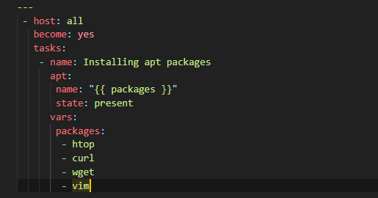
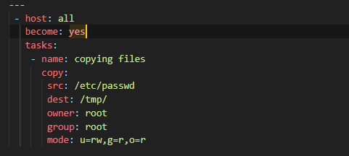
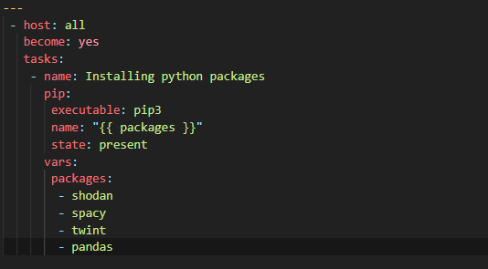
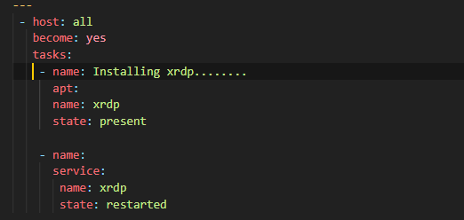
Installing apt packages
Copying files
Installing python packages
Installing & service restarting

Slide 12
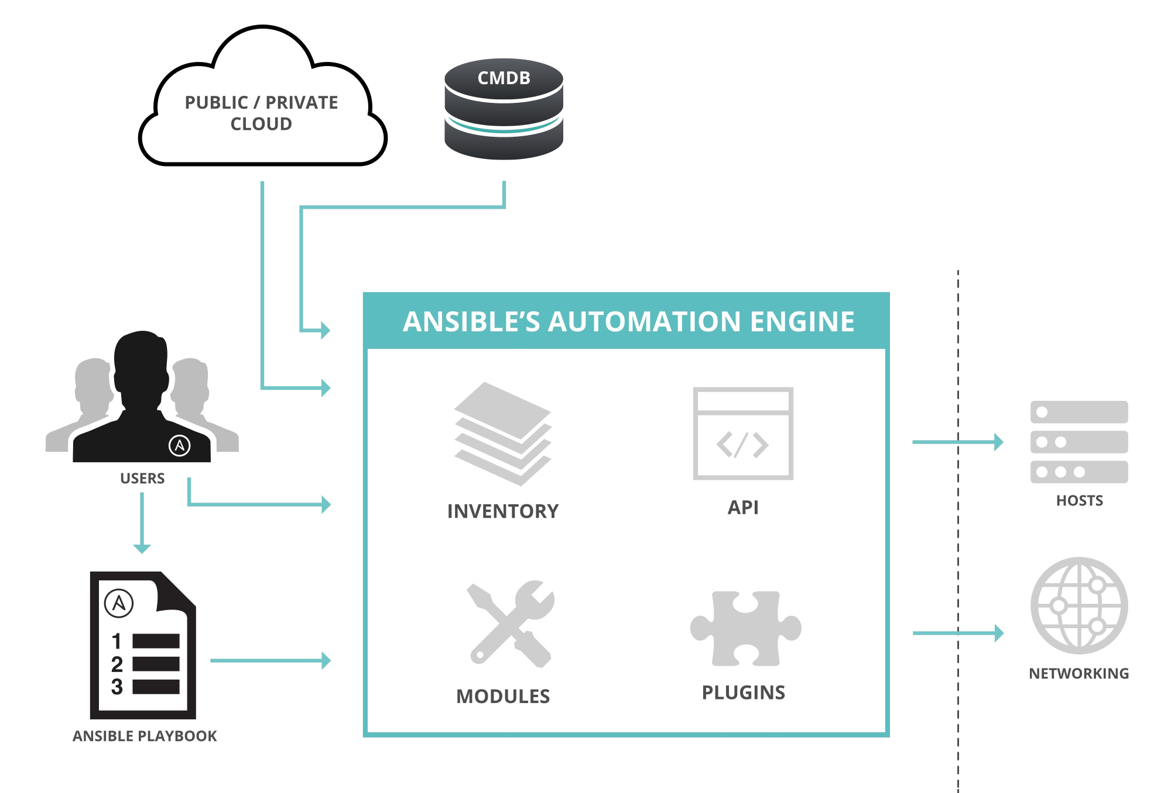
Architecture

Slide 13
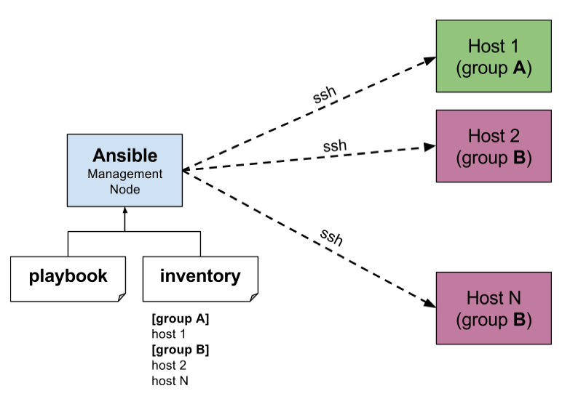
How Ansible works?

Slide 14
Ad-hoc commands
Ad-hoc commands are great for tasks you repeat rarely.
For example, if you want to power off all the machines in your lab for Christmas vacation, you could execute a quick one-liner in Ansible without writing a playbook. An ad-hoc command looks like this:
$ ansible [pattern] –m [module] –a “[module options]”
to be continued…

Slide 15
More Ad-hoc commands
Rebooting servers:
$ ansible atlanta -a “/sbin/reboot”
Executing shell command:
$ ansible atlanta -m shell -a “echo $SHELL”
Copying files:
$ ansible atlanta -m copy -a “src=/etc/passwd dest=/tmp/”
$ ansible atlanta -m file -a “src=/tmp/test.py dest=/tmp/ mode=600”
Creating directories:
$ ansible atlanta -m file -a “dest=/path/to/c mode=755 owner=root group=root state=directory ”
Deleting directories:
$ ansible atlanta -m file -a “dest=/path/to/c state=present”
Install package:
$ ansible atlanta -m apt -a “name=htop state=present”

Slide 16
Before executing playbook
Ansible must be installed on control machine(linux), optional on remote machine.
Must be same root user with same password on all machines.
Control machine’s ssh key(id_rsa.pub) should be pasted in authorized_keys of remote machine(s).
Check whether all remote hosts are alive or not
$ ansible -i host_inventory -m ping all

Slide 17
Executing Playbook
$ ansible-playbook -i host_inventory -K apt.yml
where:
ansible-playbook: to initiate command
-i: flag used to pass host_inventory files
host_inventory: simple text file containing remote hosts address
-K: to become sudo on remote machine
apt.yml: YAML file containing tasks to be executed

Slide 18
Advantages
Easy to install and configure.
Have less dependencies.
Reduce downtime.
Increase productivity.
Easy readable syntax of YAML files.

Slide 19
Disadvantages
Error reporting method is not user friendly. It will display numbers of lines in logs that will create confusion all times.
After executing playbook, we cannot edit it. If we will do ansible will not update latest changes.
Ansible is OS dependent means it is not necessary playbook that is working on Centos will work on Ubuntu also.
Somewhere it is lacking in case of Windows OS.
We can not explore ansible cli more. For that we must go with Ansible tower that is paid.

